Slide 1

India Crime Analysis Dashboard
PRESENTED BY : PAVITHRA S

Slide 2
PROJECT OVERVIEW
Power BI Dashboard Creation
Data Insights
Helps understand crime patterns and trends

Slide 3
DATA COLLECTIONS
Dataset downloaded from Kaggle
Data in Excel format
Imported into power BI

Slide 4
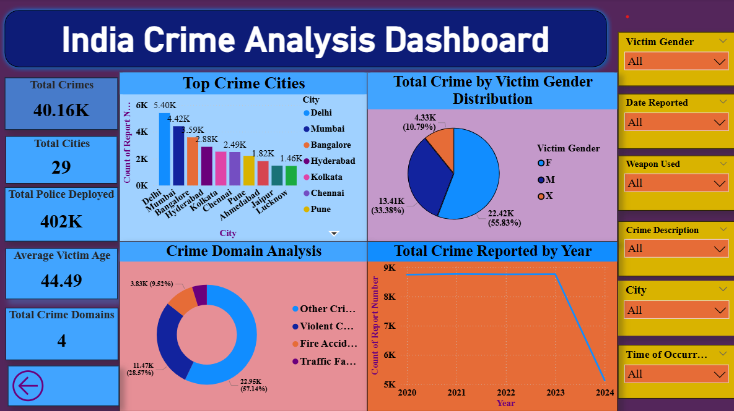
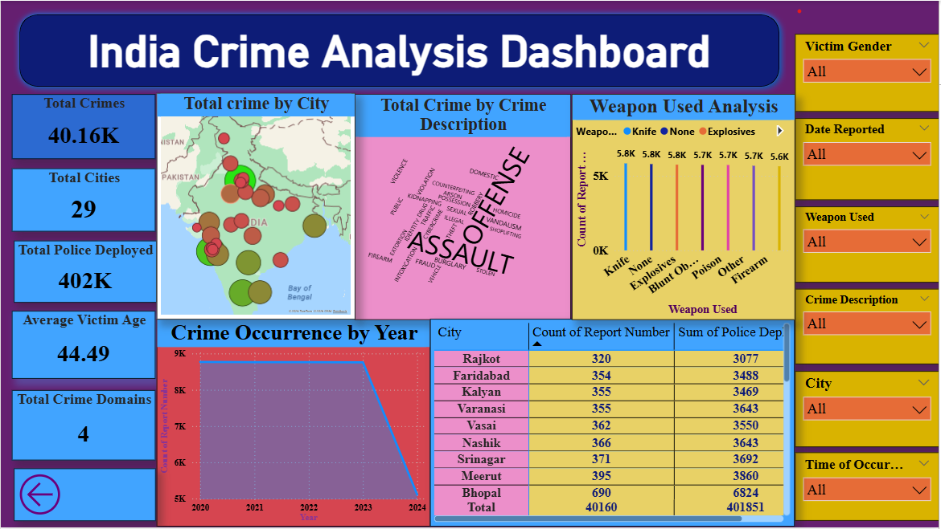
DASHBOARD OVERVIEW

Slide 5





KEY METRICS
The Key metrics shows total crimes, cities, police deployed, crime domain and Average victim age.
This values give a quick overview of overall performance.

Slide 6
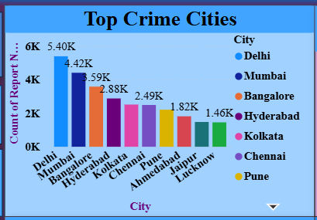
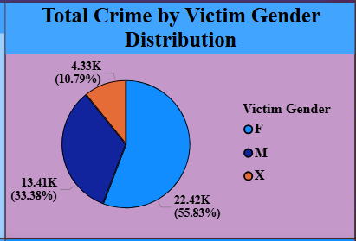
VISUAL ANALYSIS
Compare Top ten crime by city (Column chart )
Distribution of total crime by gender ( Pie chart )

Slide 7
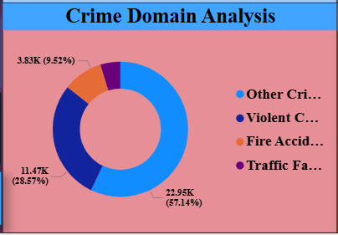
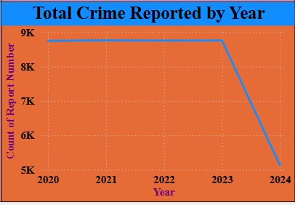
Distribution of total crime by crime domain analysis
( Donut chart )
Total crime reported trend from
2020 to 2024 ( Line chart )

Slide 8
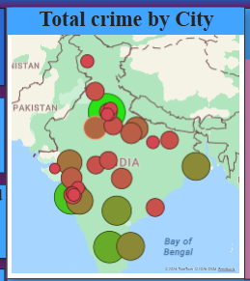

Compare total crime by location{City}( Map )
Compare the frequency of Crime by description ( word cloud chart )

Slide 9
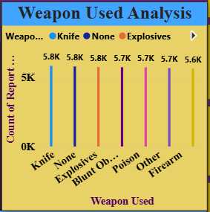
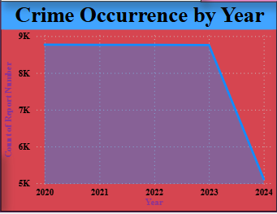
Compare total crime by
weapon used ( Column chart )
Crime occurrence trend from
2020 to 2024 ( Area chart )

Slide 10
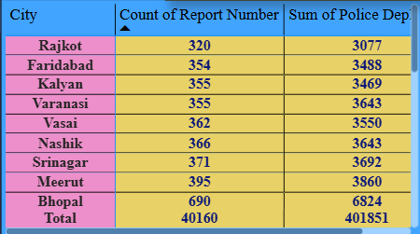
Compare detailed and
exact data format (Table)

Slide 11





INTERACTIVE FILTERS
Users can filter the dashboard dynamically

Slide 12
TOOLS USED
Power BI Desktop
Excel / CSV
Power Query
Built in visual ( Charts, Maps )

Slide 13
CONCLUSION
Dashboard helps identify crime trends.
Useful for analysis and reporting
Interactive visuals improve decision making

Slide 14


